Slide 1

Machine Learning
Session 2

Slide 2




Session 2
Content
Linear regression with one variable review.
cost function review.
gradient descent.
------Break------
pandas & numpy.
Appling with code.
Grow Through

Slide 3
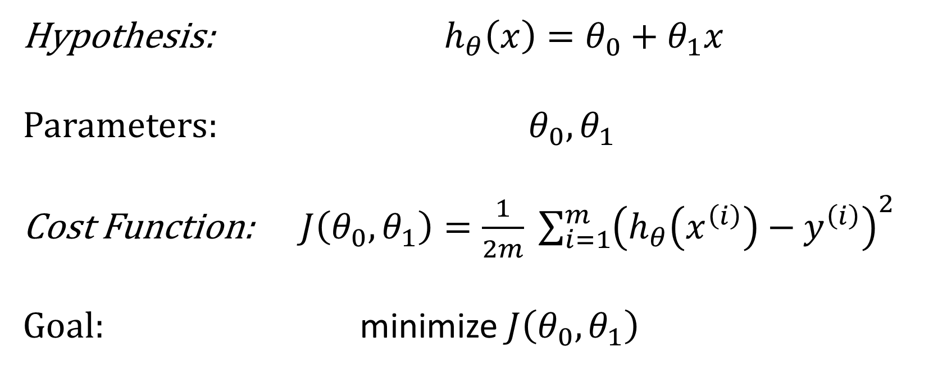
Linear Regression problem with one variable
Grow Through

Slide 4
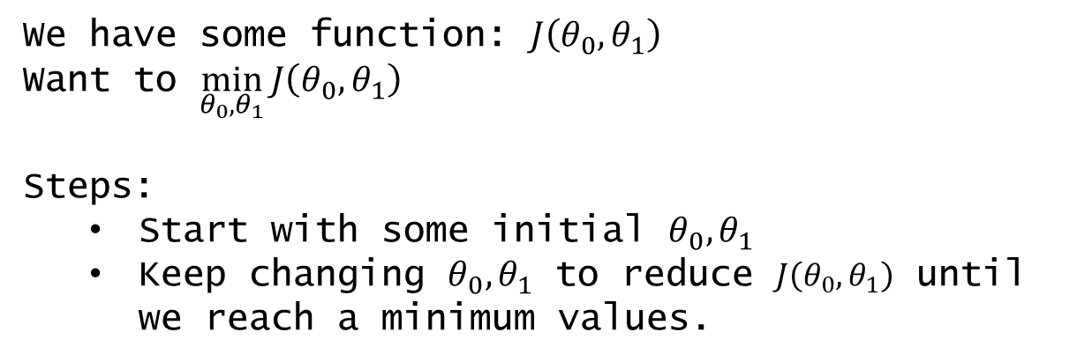
Session 2
Gradient descent
Gradient descent is a first-order iterative optimization algorithm for finding a local minimum of a differentiable function.
Grow Through

Slide 5

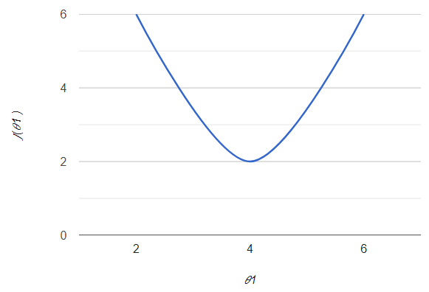
Session 2
Gradient descent
How to reach the local minimum ?
Negative slope
So the value of theta will keep increasing until it reaches the local minimum
Grow Through

Slide 6

Session 2
Gradient descent
How to reach the local minimum ?
Positive slope
So the value of theta will keep decreasing until it reaches the local minimum
Grow Through

Slide 7
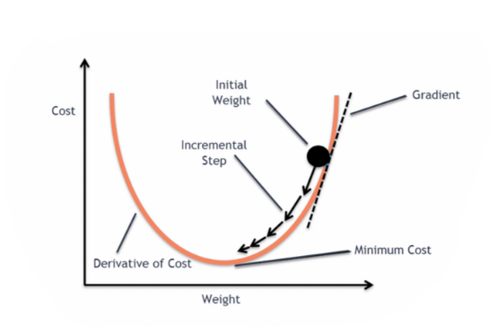
Session 2
Gradient descent
Grow Through

Slide 8
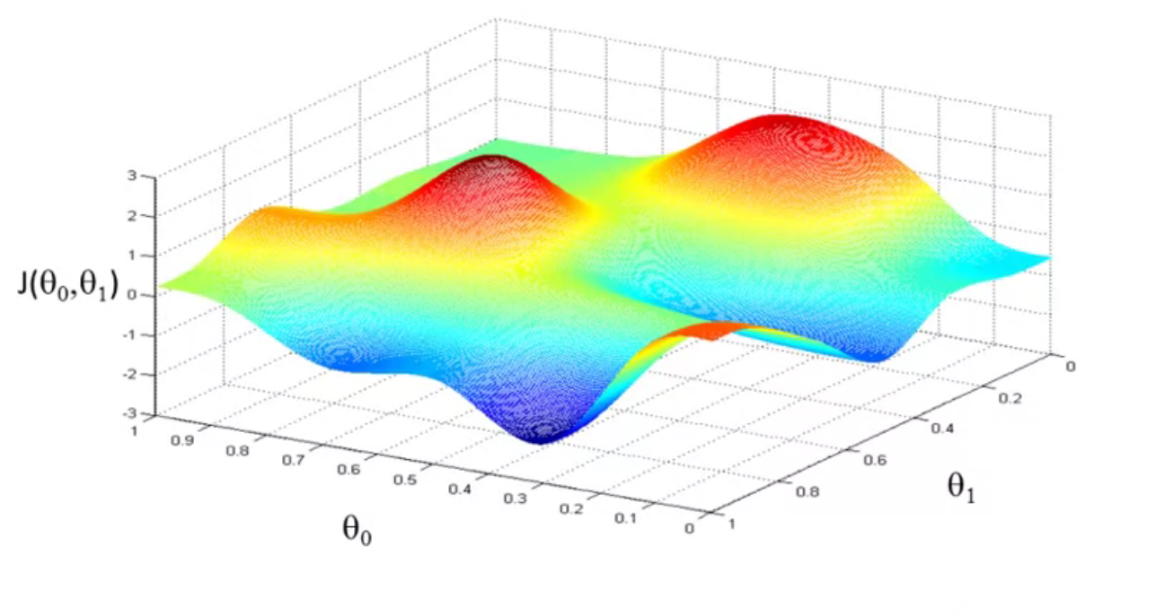
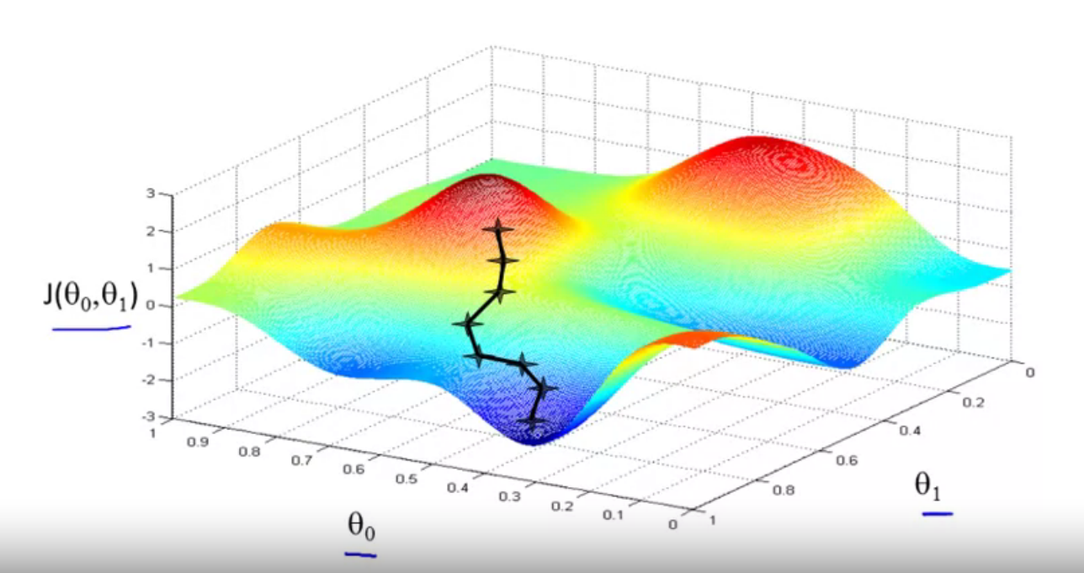
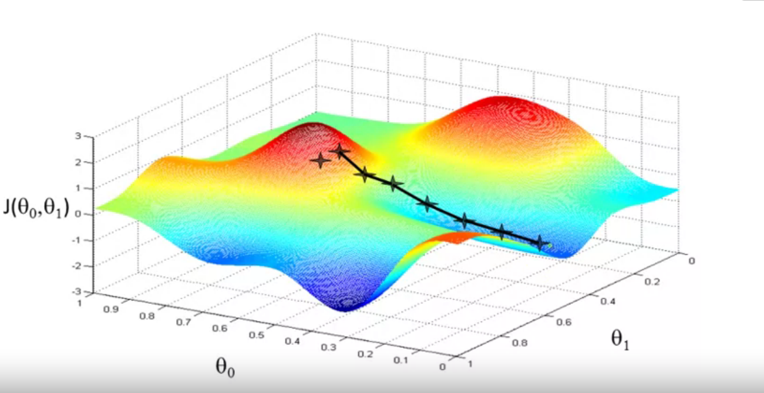
Session 2
Gradient descent
We start with an initial value then we keep changing until we reach a local minimum.
Local minimum
Grow Through

Slide 9
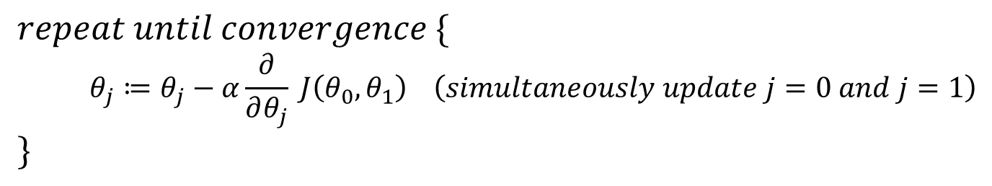
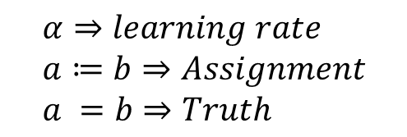
Session 2
Gradient descent algorithm
Grow Through

Slide 10
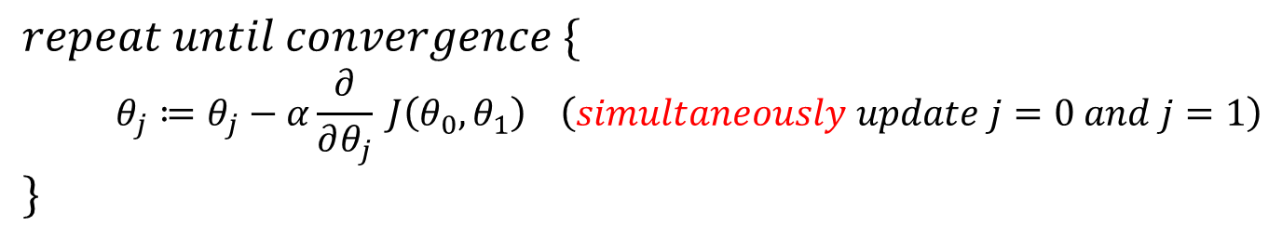
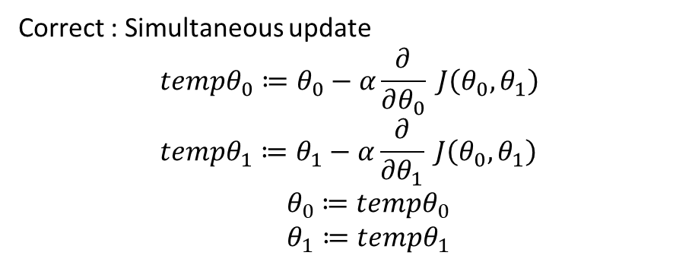
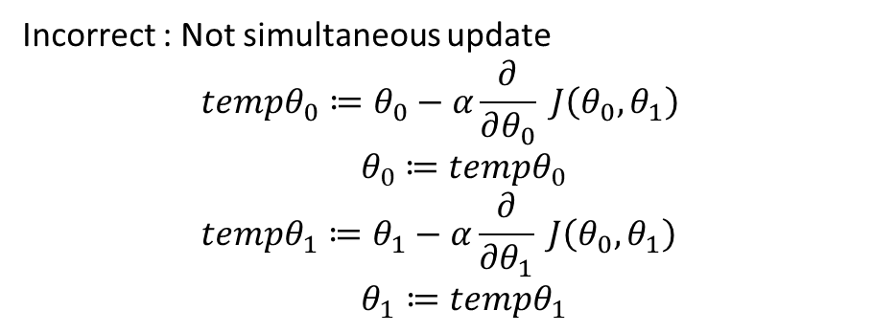
Session 2
Gradient descent algorithm
Grow Through

Slide 11

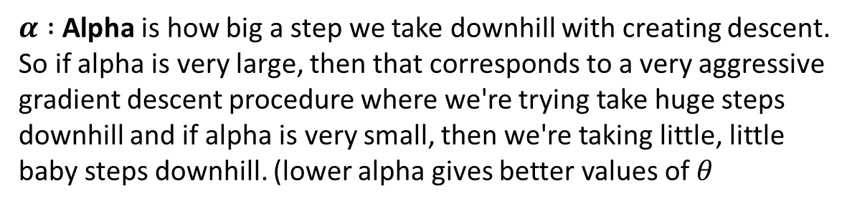
Session 2
Gradient descent algorithm
How to choose ALPHA
Grow Through

Slide 12


Session 2
Gradient descent
Grow Through

Slide 13
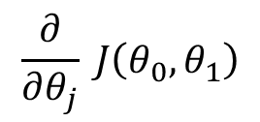
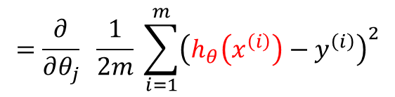
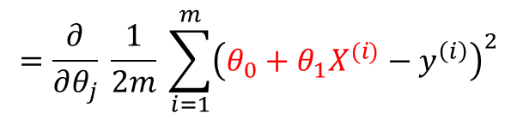
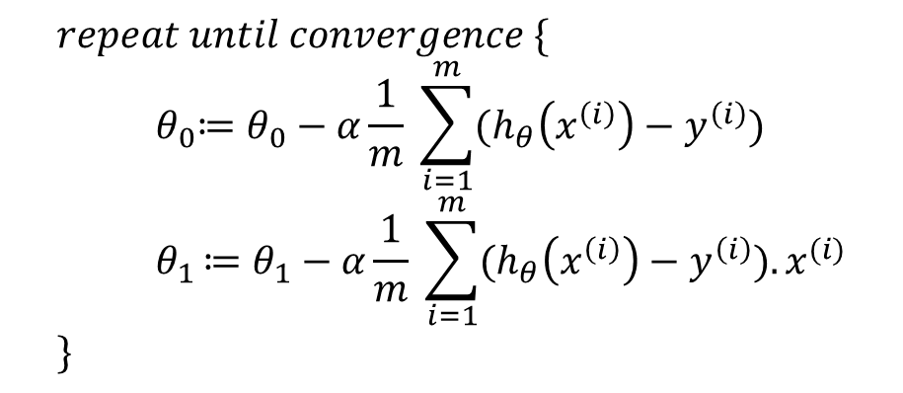
Session 2
Gradient descent equation
Grow Through

Slide 14
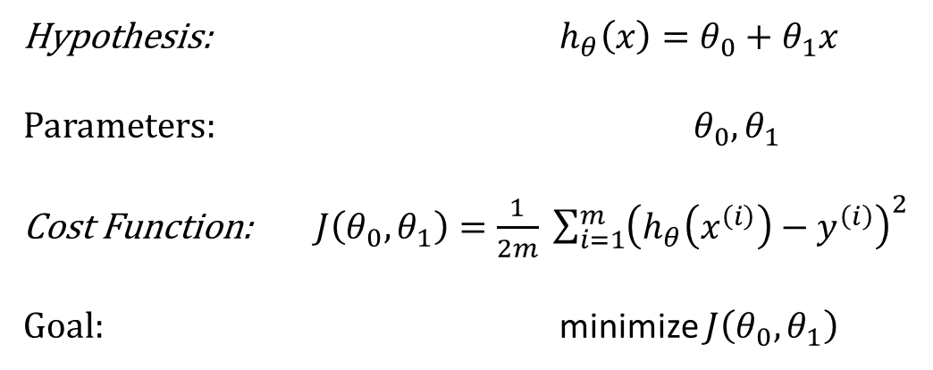
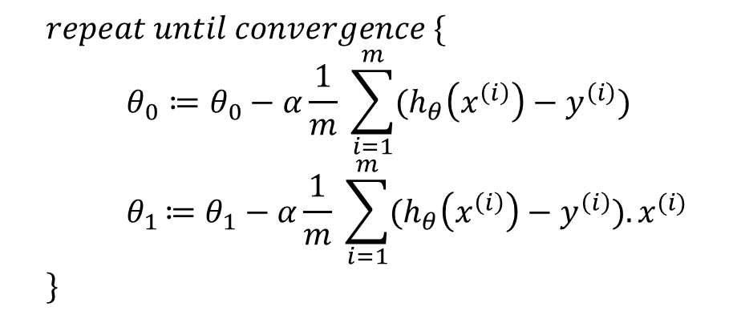
Session 2
All Equations:
Linear regression model
Gradient descent algorithm
Grow Through

Slide 15
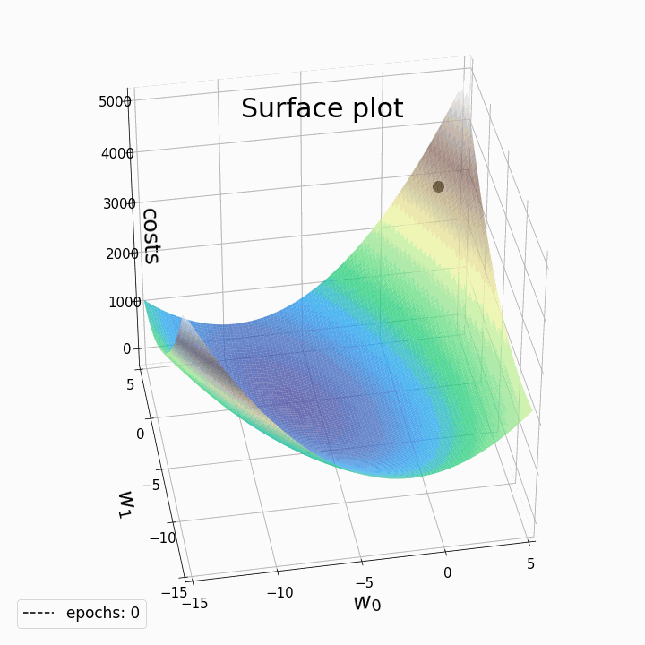
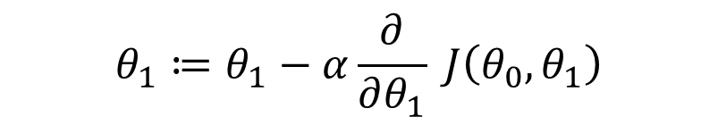
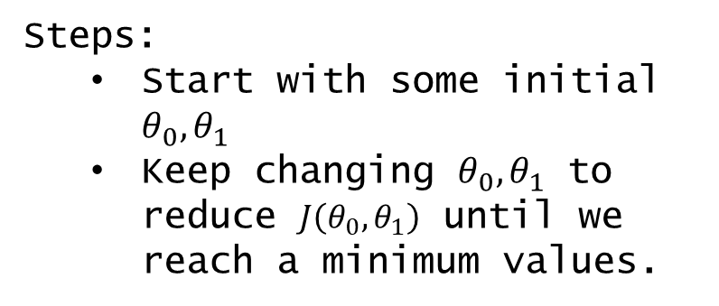
Session 2
Gradient descent
Grow Through

Slide 16

Session 2
Gradient descent
Grow Through

Slide 17
Goodbye
Grow Through

